Slide 1
SharePoint Upgrade or Migration, or is it both?
Chirag Patel @techChirag
Notes:
Most organisations use the terms SharePoint upgrade and migration interchangeably, but there are major differences that can have impact on project cost, effort required and skills on the desired outcome. This session aims to solve those hidden costs and differences by discussing the benefits and drawbacks for both upgrade and migration approaches.

Slide 2

Business Challenges
Migration and Upgrade commonly used interchangeably
Understanding of available options and solutions
Significant investments in hardware and software platforms
Employing expertise (and in-house) – not just technical!

Slide 3

Chirag Patel (MCSE, CITP)
SharePoint & Office 365 Consultant
Patel Consulting
www.techChirag.com
@techChirag
15+ years SQL Server, SharePoint and Office 365
Regular speaker at #spsevents #suguk events

Slide 4

About Chirag
SharePoint Installation & Configurations
SharePoint Upgrade & Migrations
Office 365 Migrations
SharePoint Business Solutions
Design & Implement Intranets
SharePoint Workflows and Forms
Project Online Implementations
SQL Reporting Services & Power BI
SQL Database Design

Slide 5

What will we cover?
Business Objectives
Readiness Assessment
Upgrade Approach
Migration Approach

Slide 6

Business Objectives
Why do you need to deploy SharePoint 2016?
What are the drivers of change towards Office 365?
Are there any limiting capabilities with current SharePoint version?
How can we reverse engineer customisations?
Does your target operating environment need to be re-architected?
How can we capitalise on Hybrid migrations?

Slide 7

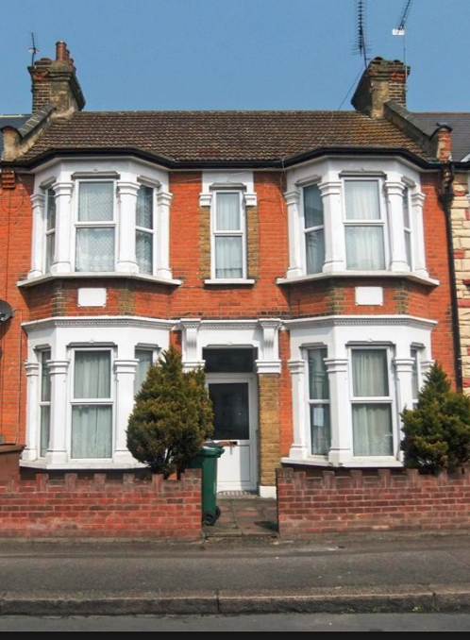
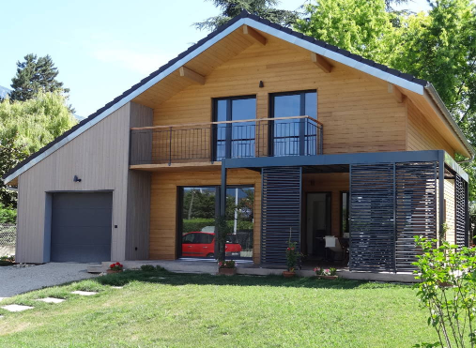
Upgrade vs Migration
Upgrade
Migration

Slide 8
Readiness Assessment

Slide 9

Service Catalogue
Team Collaboration Site
Meeting Management Site
Project Collaboration Site
Business Applications
Business Service
SharePoint Service
Apps
Extranet
Intranet
Team Collaboration
Know your technical boundaries for your SharePoint services
Identify common business services that users request
Aligning your training, support and advisory services

Slide 10

SharePoint Content Inventory
Formal/Informal content
High business value sites
Sites and Owners
Permissions
Users
Features
Customisations (including custom code)
http://techchir.ag/sp2013upgradeworksheet
Notes:
Key factors are quantity, size and metadata architecture

Slide 11
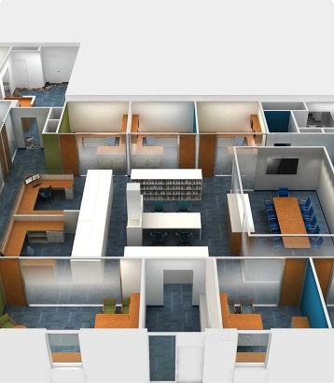
Information Architecture
Content Type Hub
Metadata Term Stores
Content Types
Site Columns
Search Content Sources
Search Managed Properties

Slide 12

SharePoint Customisations
Add-ins
Full Trust Code Solutions
Features
Site Themes
Web Config File
SharePoint Hive
HTML5, CSS, JavaScript
SharePoint ISV Custom Framework
Custom code portability
Custom list templates
Custom site templates
Custom web parts
Third-party web parts
Feature stapling

Slide 13
Reorganise SharePoint Hierarchy
SharePoint Farm
Servers
Service Applications
Web Applications
Databases
Site Collections
Sites
Libraries and Lists
Folders, Document Sets
Documents, Items and Pages
Move site collections between databases
Promote sites to site collections
Demoting site collection to site
Merging or splitting lists
Usable information management and performance

Slide 14

Pre-Upgrade Checks!
Large Content Databases & Large Site Collections
200GB limit challenges Database backup times, moving databases, restore databases
Checked out files
Site Collection health checks
Non-standard authentications, i.e. Classic and Forms Authentication
Check for scheduled tasks, errors and dependencies
Process and communication hoops
Plan for capacity and decent test environments

Slide 15
Upgrade Approach

Slide 16


Release History and Roadmap
SharePoint
Portal Server 2001
SharePoint
Portal Server 2003
Office SharePoint
Server 2007
SharePoint
Server 2010
SharePoint
Server 2013
SharePoint
Server 2016
2001
2003
2006
2009
2012
2016
Microsoft
Managed Solutions
Microsoft
Online Services
Office 365
Core
Collaboration
Content
Management
Cloud and Enterprise
Social
Cloud-Inspired
Experiences

Slide 17

SharePoint Minimum Requirements
 | SharePoint 2010 | SharePoint 2013 | SharePoint 2016
Web & App Servers | 64-bit, 4 cores 8GB RAM | 64-bit, 4 cores 12GB RAM | 64-bit, 4 cores 16GB RAM
Database Servers | 64-bit, 4 cores 8GB RAM | 64-bit, 4 cores 8GB RAM | 64-bit, 4 cores 16GB RAM
Software | 64-bit SQL Server 2012 64-bit SQL Server 2008 R2 64-bit SQL Server 2008 SP1 CU2 | 64-bit SQL Server 2012 64-bit SQL Server 2008 R2 SP1 | 64-bit SQL Server 2014 SP1
OS | 64-bit Windows Server 2008 R2 64-bit Windows Server 2008 SP2 | 64-bit Windows Server 2012 64-bit Windows Server 2008 R2 SP1 | 64-bit Windows Server 2012 R2

Slide 18

SharePoint Version Upgrade
MOSS 2007
SharePoint 2010
SharePoint 2013
In-place upgrade
Database-attach
Database-attach
Database-attach
SharePoint
Server 2016
Upgrading is done on a database-by-database basis
Option of testing upgrade using the Test-SPContentDatabase powershell cmdlet
Downtime minimised by setting database to read-only mode
Migration of content to SharePoint Online (Office 365) not supported.
New Farm must be provisioned with all types of customisations.
Orphaned web sites or site collections will not be resolved.
Cannot upgrade individual sites or site collections

Slide 19

SharePoint Server 2016 Upgrade Process
Create SharePoint Server 2016 Farm
Copy Databases to New Farm
Upgrade Service Applications
Upgrade Content Databases and Site Collections

Slide 20
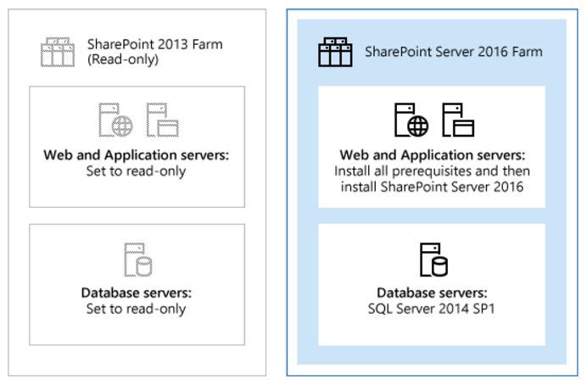
Create new farm, set old farm to read-only
http://techchir.ag/sp2016upgrade

Slide 21
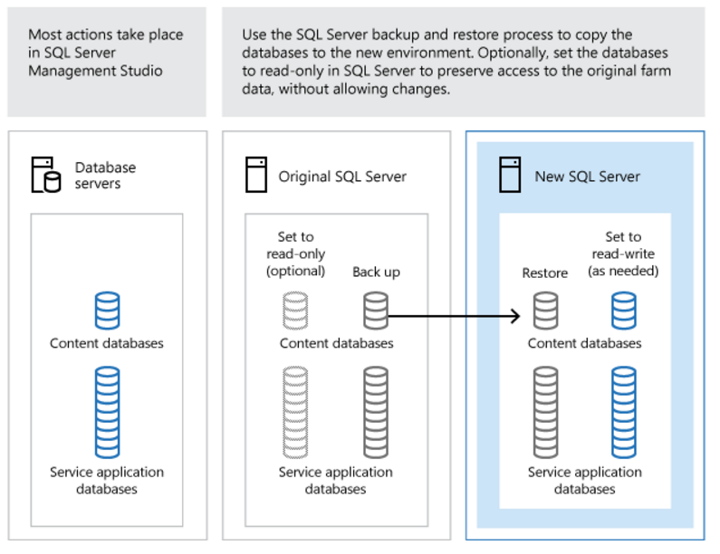
Copy Databases to New SQL Server
http://techchir.ag/sp2016upgrade
Notes:
Includes Content Databases and Service Application Databases

Slide 22
Upgrade SharePoint Server 2013 with SP1 databases and service applications
Business Data Connectivity service application
Managed Metadata service application
PerformancePoint Services service application
Search service application
Secure Store Service application
User Profile service application

Slide 23
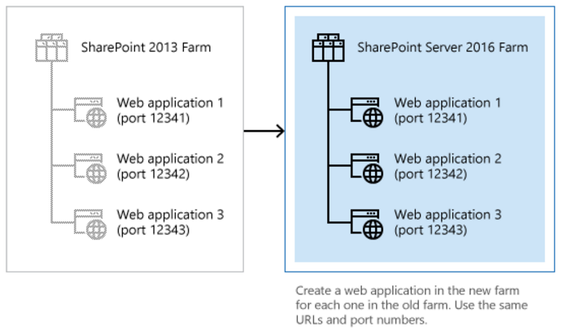
Create web applications for upgrade
http://techchir.ag/sp2016upgrade

Slide 24
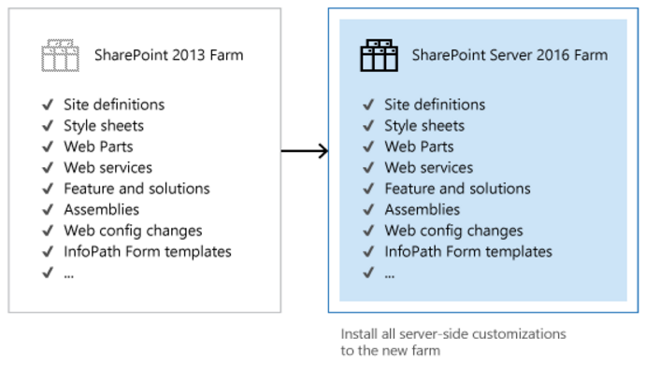
Copy & Install customisations to the new farm
http://techchir.ag/sp2016upgrade

Slide 25
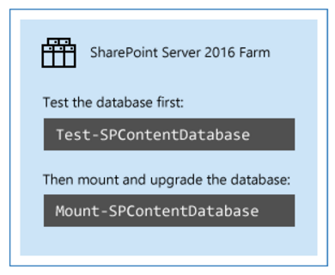
Upgrade the databases by using Windows PowerShell
http://techchir.ag/sp2016upgrade
Notes:
Test-SPContentDatbase
Mount-SPContentDatabase

Slide 26
Upgrade SharePoint Server 2013 with SP1 site collections
Site owners are in charge of upgrading their sites
Owners can upgrade their site collections as soon as they see a notification on their site's home page that the new version is available
Farm administrator can also force specific site collections to be upgraded without waiting for the site owners to upgrade them
http://techchir.ag/sp2016upgrade

Slide 27
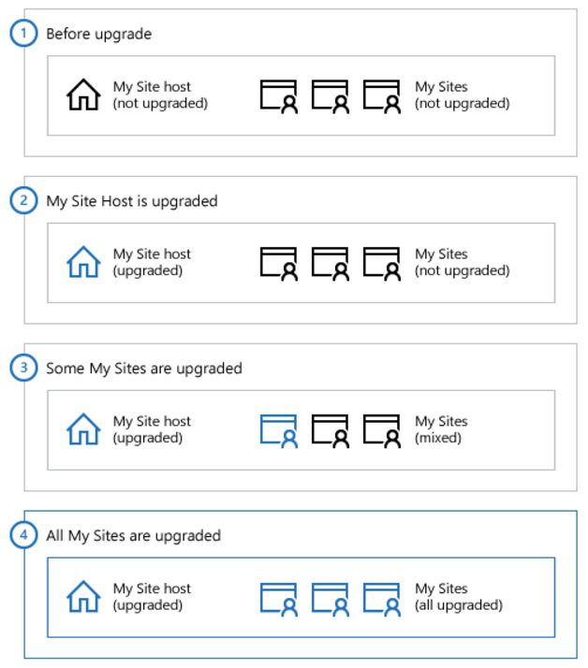
Upgrade My Sites (Site Collections)
http://techchir.ag/sp2016upgrade

Slide 28
How to test upgrade?
Web Parts
Large Lists
Styles & Appearance
Customised Pages
Do all the Web Parts from your original site show up in your upgraded site?
Are the Web Parts displayed correctly?
Are there extra or missing Web Parts?
Are any pages still checked out?
Did you create your connections again correctly?
Are external data sources still working?
Are there any large lists in your environment that must be reworked?
Are all images on your pages displayed correctly?
Are the appropriate cascading style sheet colors and styles used in the appropriate places?
Theme choices are different in SharePoint 2013 – which theme do you want to use?
Do you have any JavaScript controls that are not working?
Are your pages displayed correctly in the browser?
Are there any script errors displayed on any pages?
Are your customizations still in place?
Can you still get to the editing controls on the pages?
Are your customizations still appropriate in the new environment, or do you want to update to the new functionality and look?
Are any pages still checked out?
http://techchir.ag/sp2013testupgrade

Slide 29
Migration Approach

Slide 30
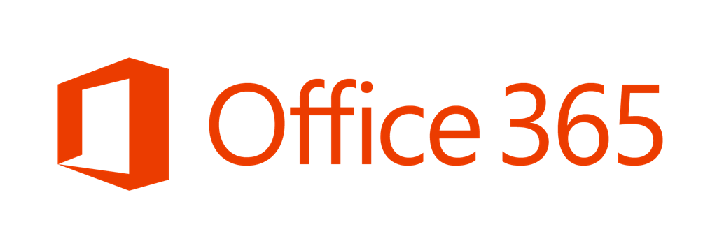
Pathway to SharePoint and Office 365 Migrations
SharePoint
Online
MOSS 2007
SharePoint 2010
SharePoint 2013
Full or Selective Migrations
Full or Selective Migrations
Full or Selective Migrations
SharePoint
Server 2016
Notes:
Third-party Migration tools accelerate desired outcome.

Slide 31

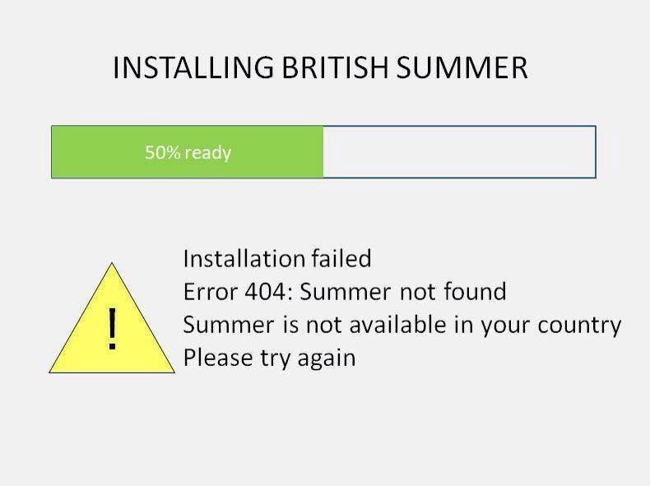
Migration Considerations
Security Mapping
Users, groups and permission levels
Site Structures
Web Parts, Content types, Site Columns, Libraries, lists, folders and items
Metadata
Organisation metadata, Created By, Modified By, Created, Modified
Complete Site by Site basis
Pick and choose sites (or subsites) to destination site collections
Entire Site Collections
Promote site to site collections
Site Configurations
Workflows, Views, Alerts, Navigation

Slide 32
Future of SharePoint

Slide 33
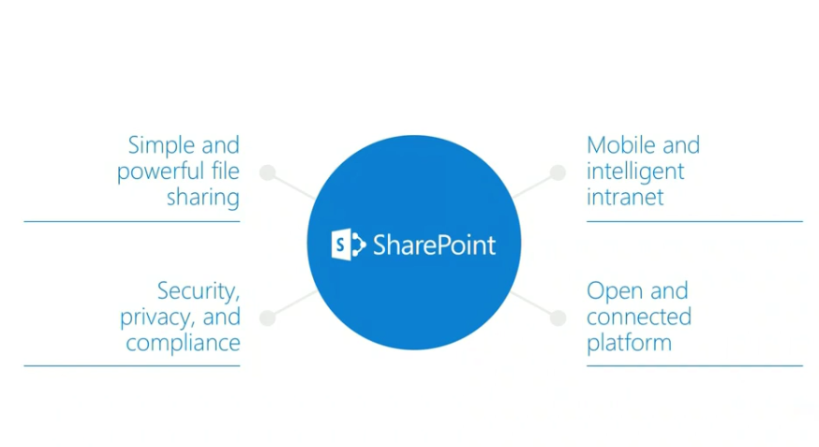
SharePoint Vision & Roadmap
Notes:
4 Pillars of SharePoint Roadmap

Slide 34
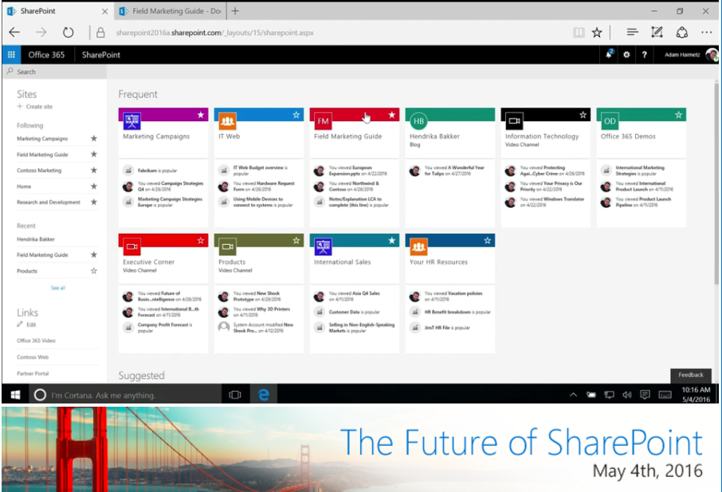
SharePoint Analytics

Slide 35
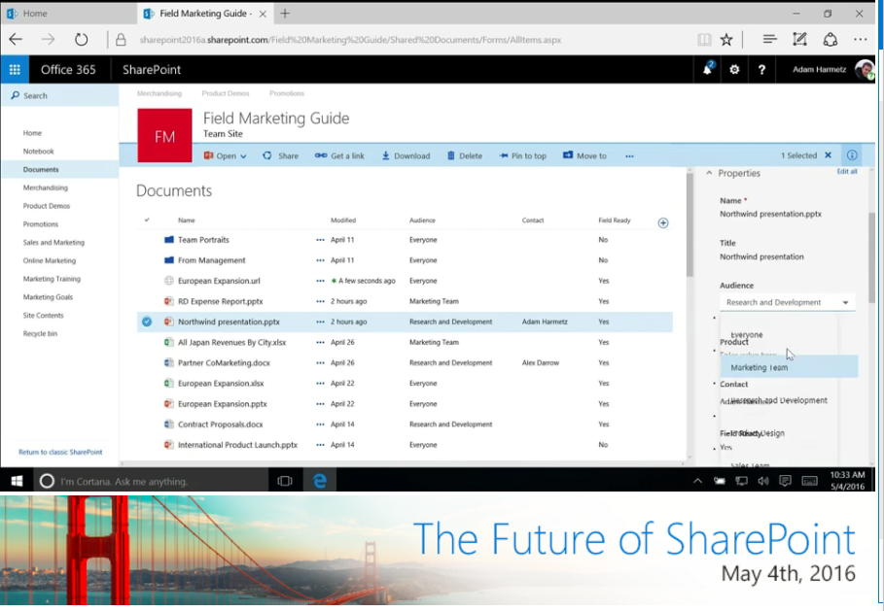
Metadata Information Pane

Slide 36
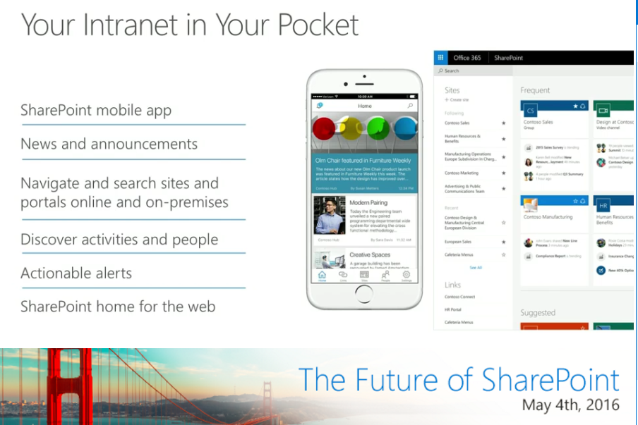
SharePoint Mobile App - Your Intranet in Your Pocket

Slide 37
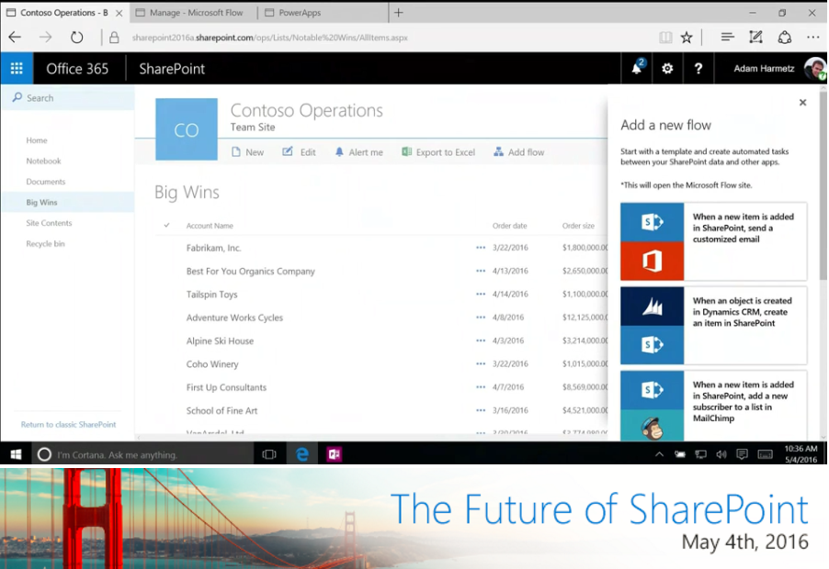
Native Integration of Microsoft Flow and Power Apps

Slide 38
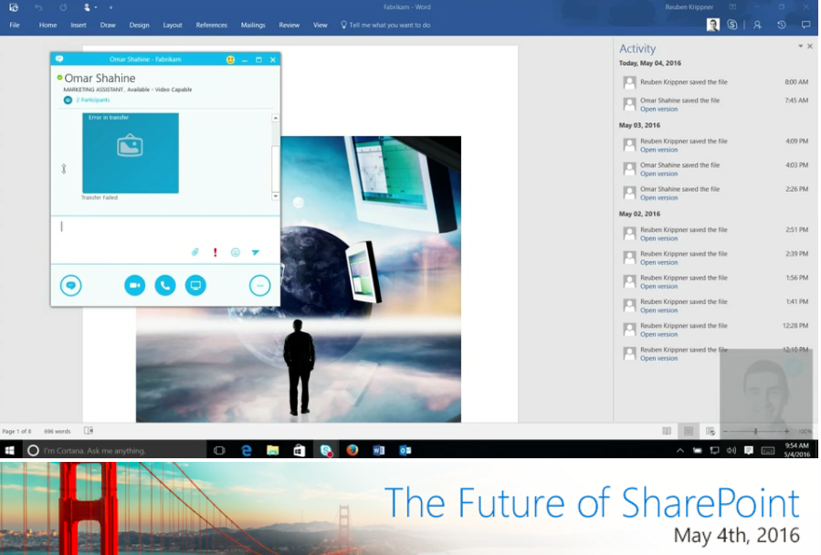
Activity Pane and Skype Document Chat

Slide 39
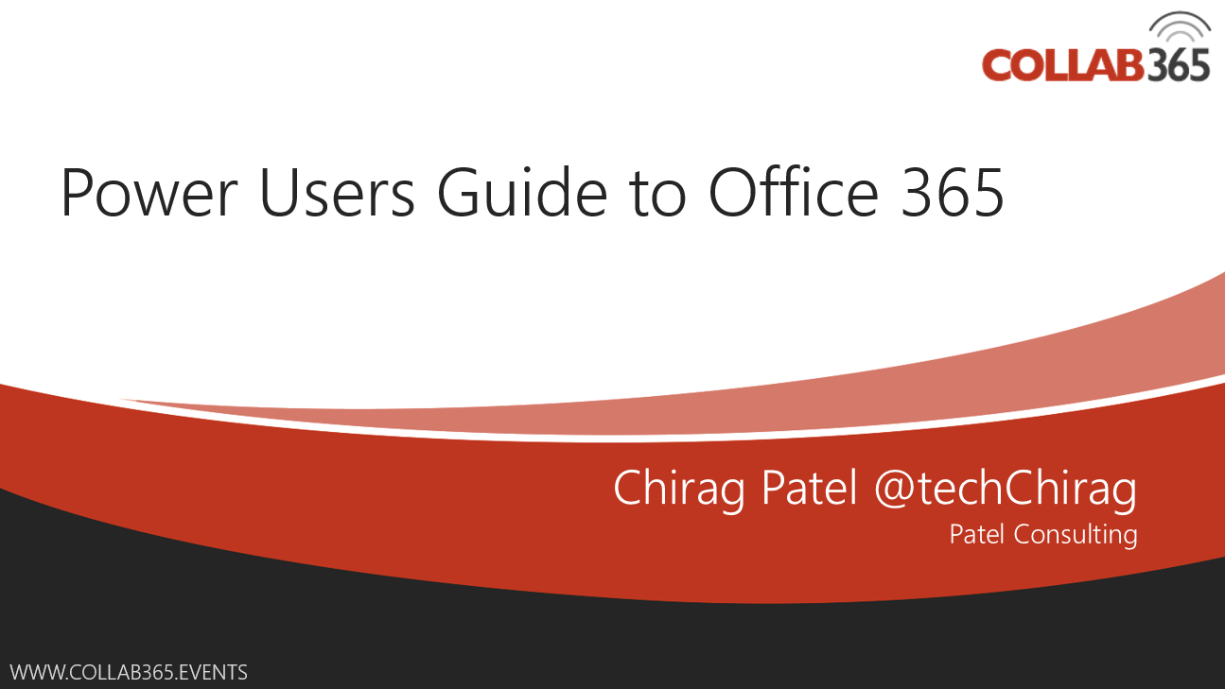


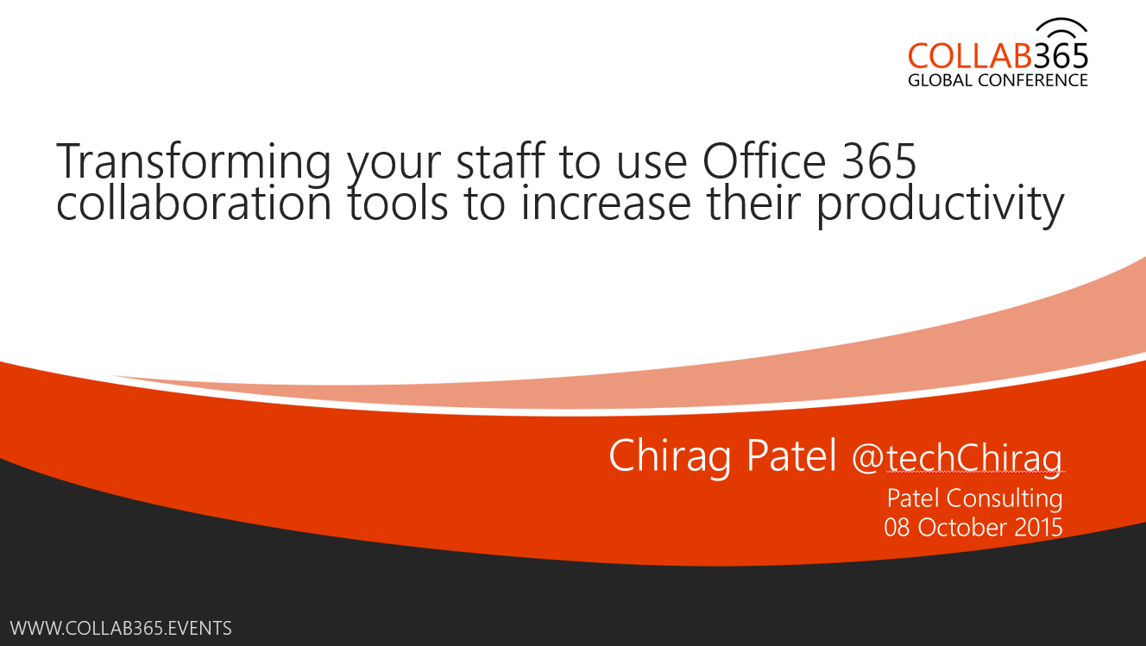
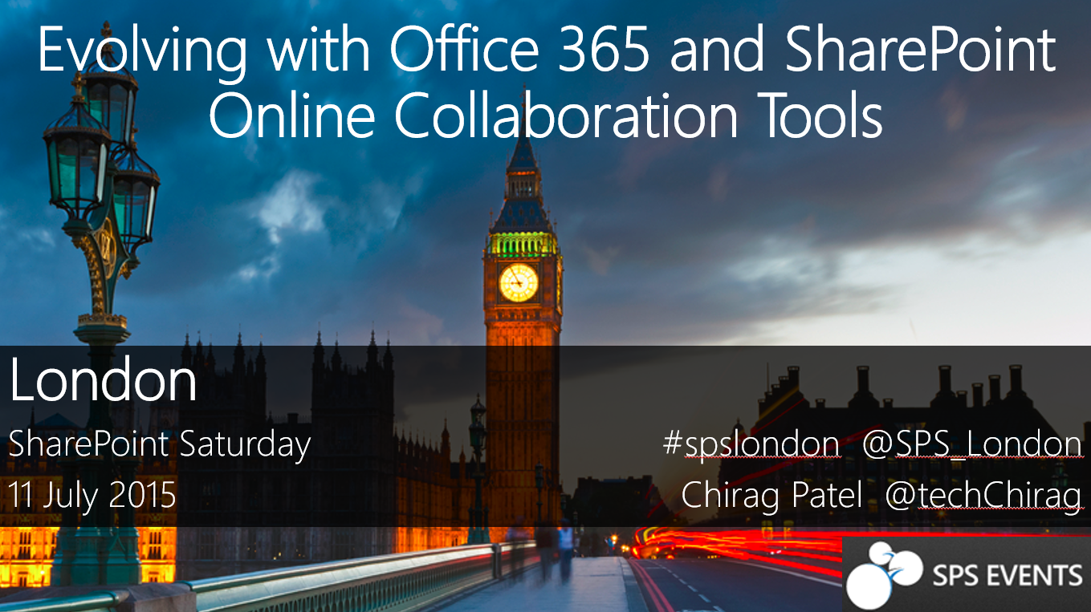
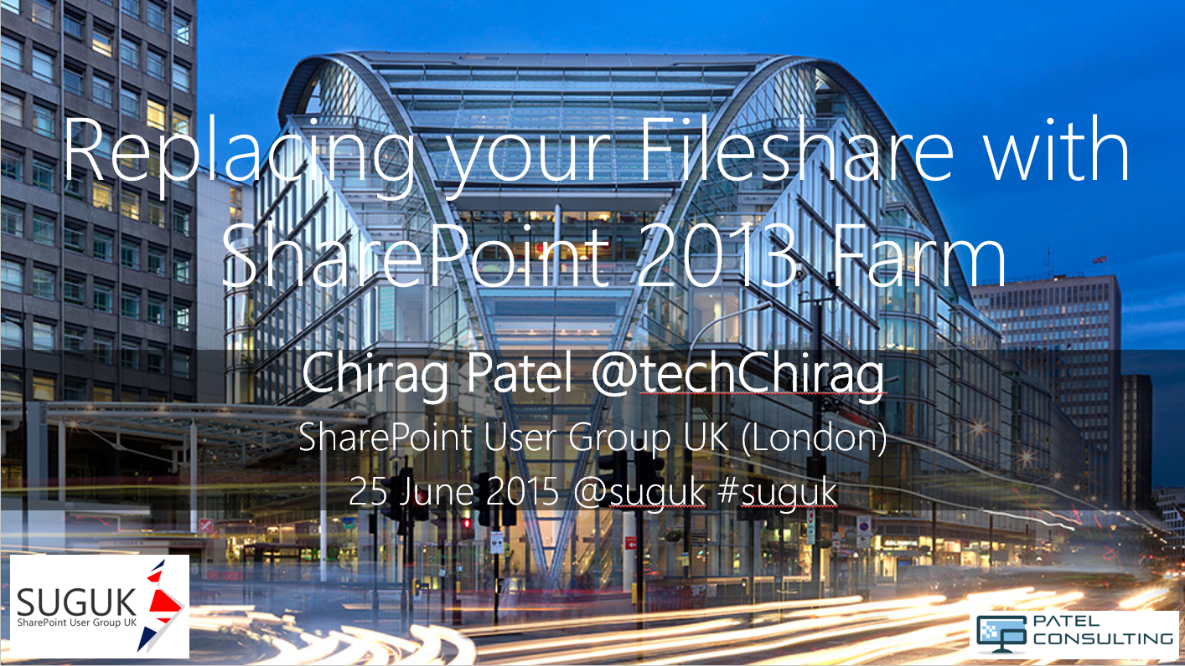

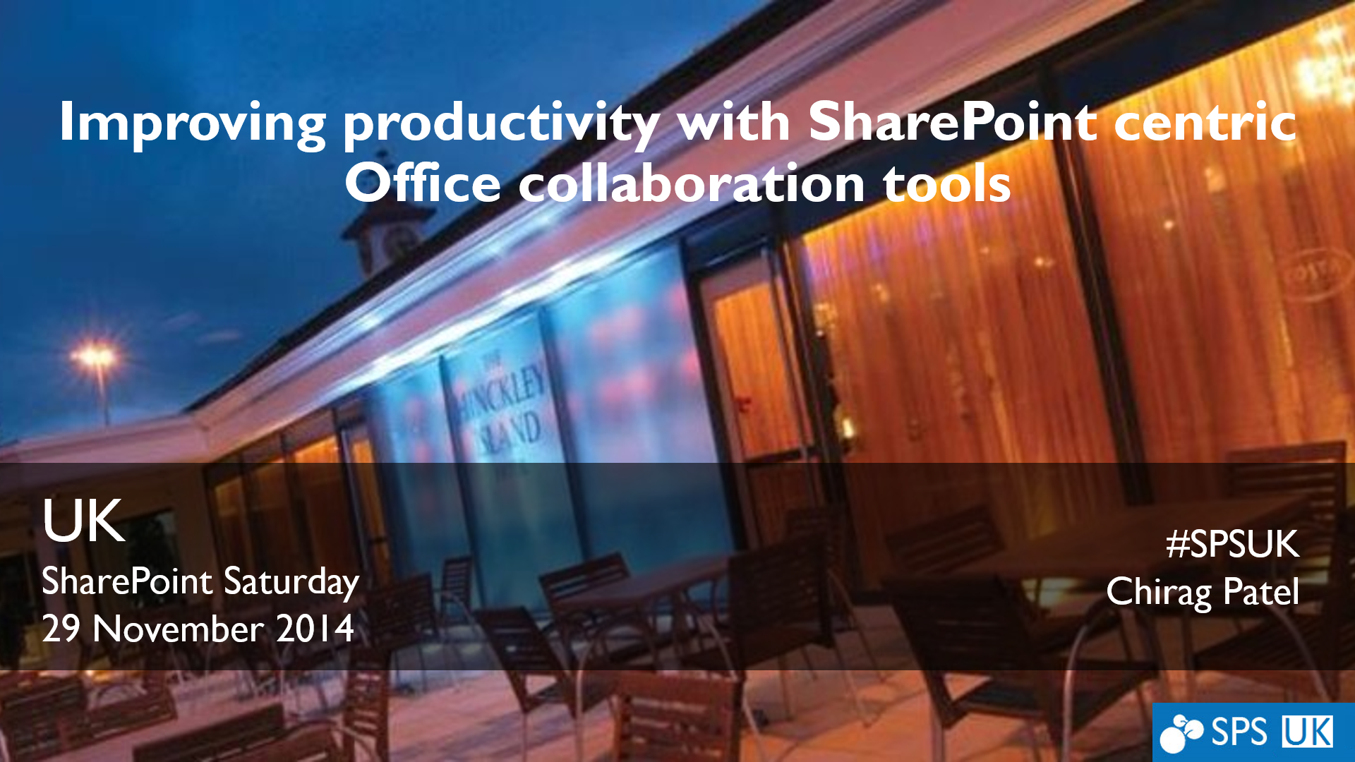
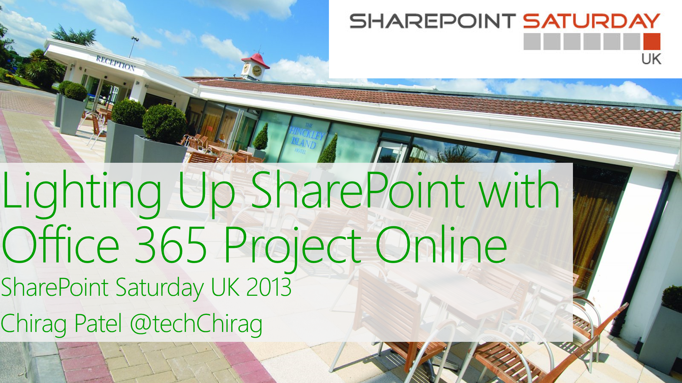
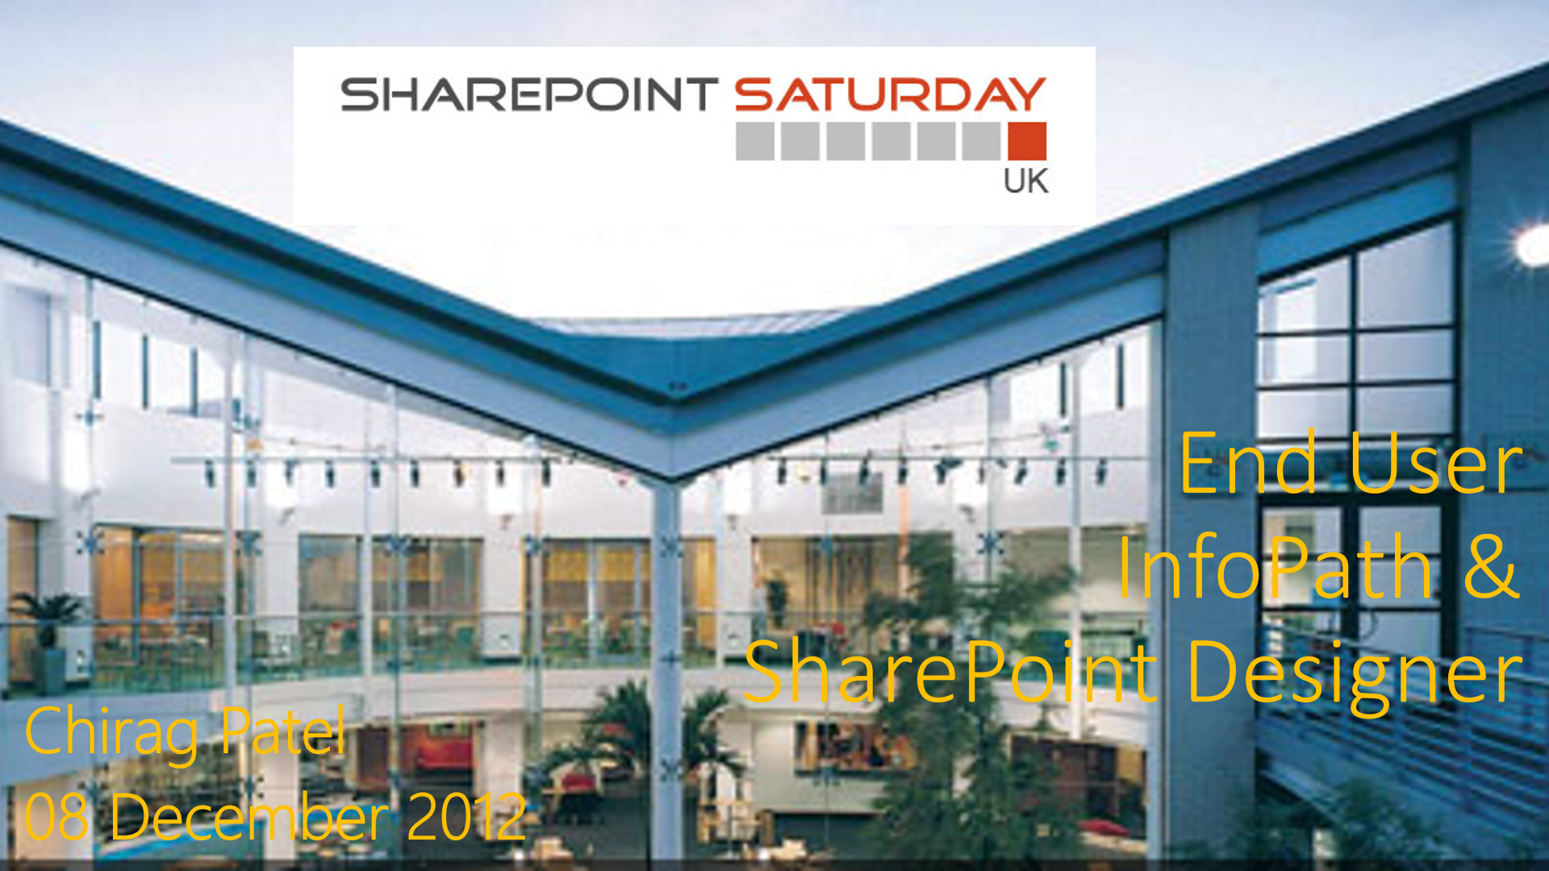
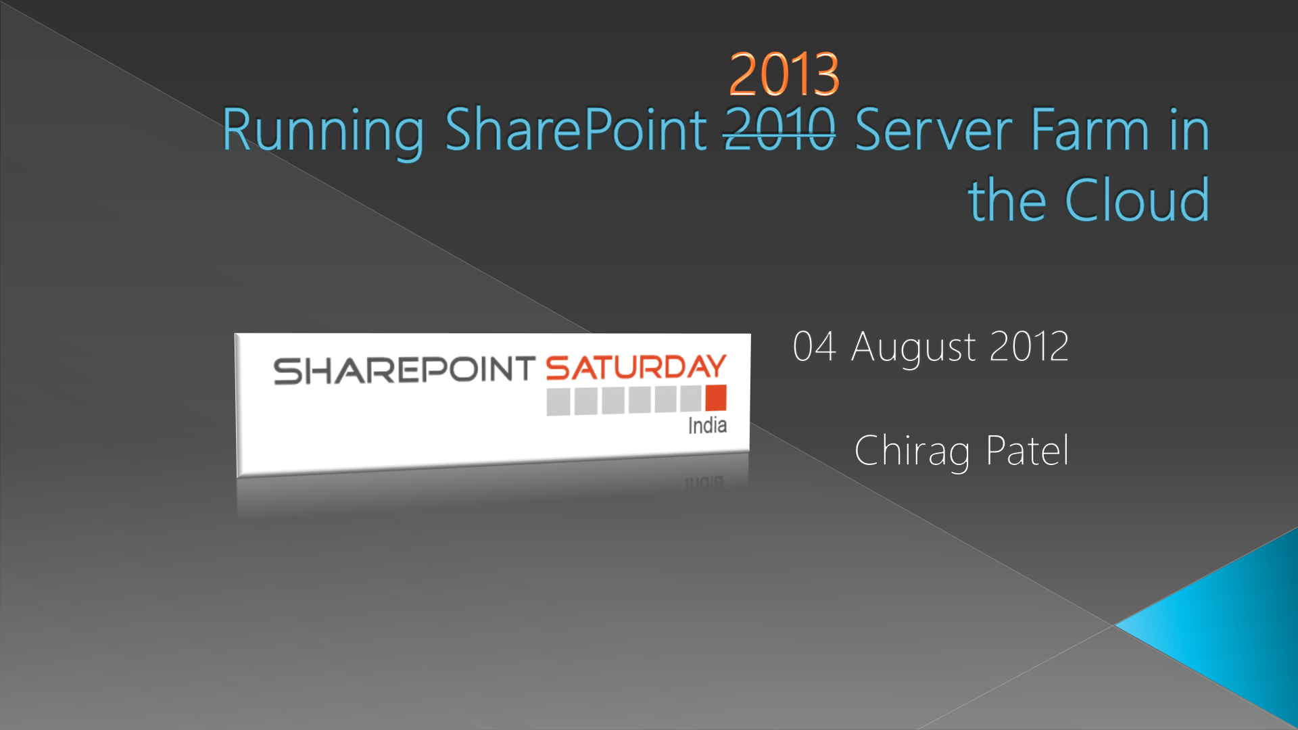
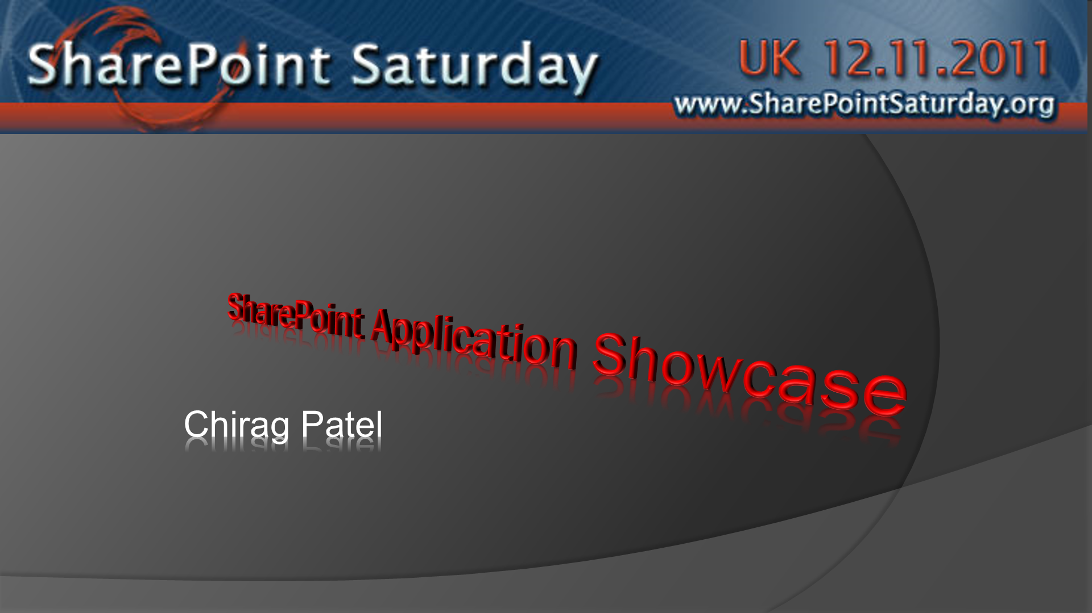
slideshare.com/techchirag

Slide 40
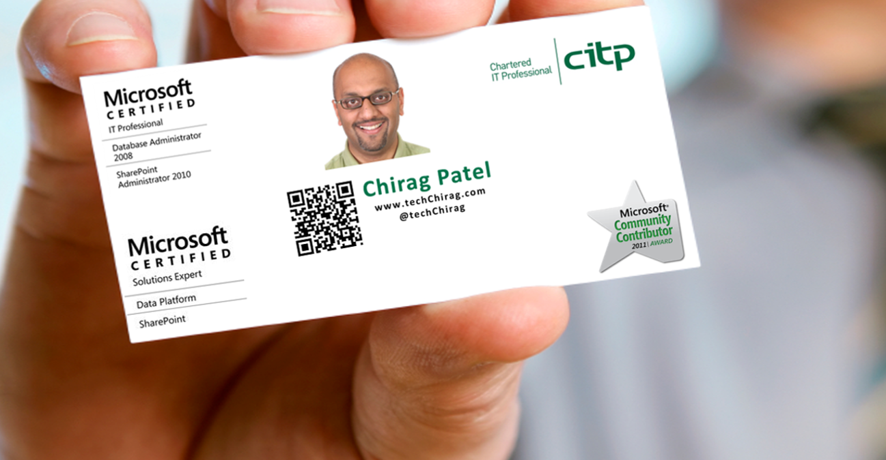
Thank You!

Slide 41
Notes:
Thank you to our sponsors and organisers!

Slide 42
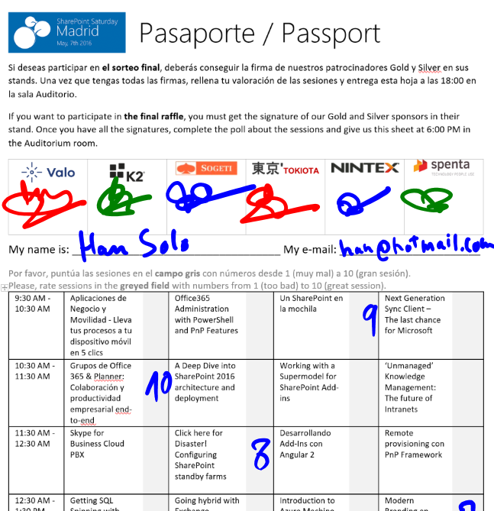
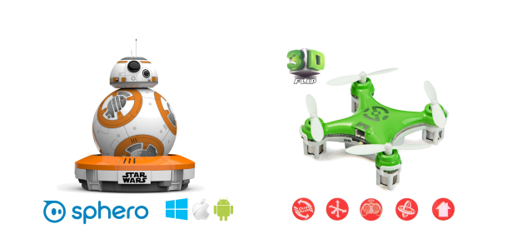
Raffle
Please, fill your SPS Madrid passport if you want to participate.
You must get signature from sponsors and complete the poll.
Give us the passport at 6:00 PM in the Auditorium room.
You can win one Sphero BB-8 or a mini drone:

